Slide 1





RESUME CREATOR

Slide 2

TEAM MEMBERS
Aman Gulwani (181500069)
Vishal Verma (181500811)

Slide 3
INTRODUCTION
RESUME CREATOR
BUILD RESUME
EASY &FREE TO USE
AVAILABLE ON ALL DIGITAL DEVICES

Slide 4
SOFTWARE STRUCTURE AND DESIGN
VISIT WEBSITE
CREATE ACCOUNT/SIGN-UP
SIGN-IN
USE FUNCTIONALITY OF WEBSITE FOR STYLING INTERACTIVE RESUME/CV
END

Slide 5

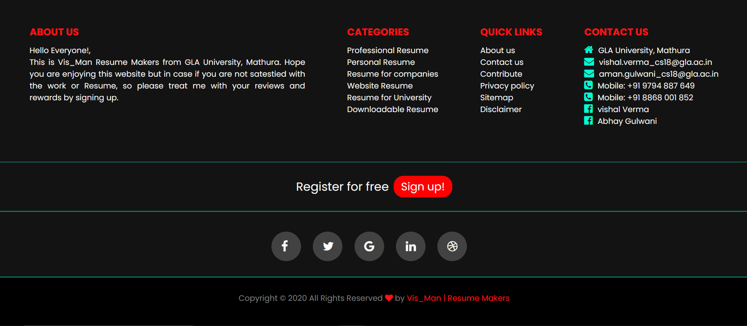
LANDING PAGE
The Homepage Of The Website. Anyone Who Comes To The Website For Fetching Details Or Login/Signup Will Be Welcome By The Homepage.

Slide 6
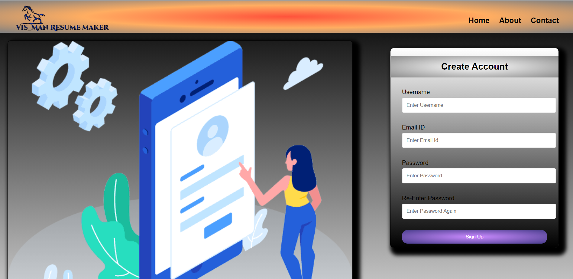
SIGN-UP PAGE

Slide 7
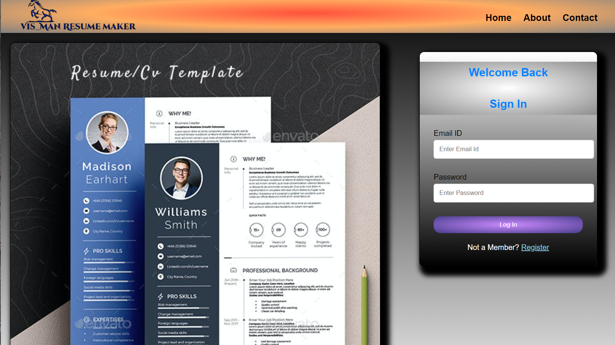
SIGN-IN PAGE

Slide 8


HARDWARE REQUIREMENT
Computer with RAM greater than 2 GB
Computer with i3 or above versions of Intel processors.
Active internet connection provider Wi-Fi module
SOFTWARE REQUIREMENT
Visual Studio Code & Brackets
Windows 7 or above versions
Adobe XD
Web Browers and Xampp Server

Slide 9


LANGUAGES USED
FRONT-END
HTML 5
CSS
JAVASCRIPT
BOOTSTRAP
BACK-END
PHP
MYSQL

Slide 10
KEY FEATURES
Robust and as well as Mobile compatible Website.
Clean and simple designing with easy navigation
High Quality Imagery with secure and reliable communication channel
Digital accessibility with easy interface

Slide 11
THANK YOU

